Slide 1

Functions
19CSE102 Computer Programming

Slide 2
Functions in C Programming
A function is a block of statements that performs a specific task.
Why do we need functions in C?
To improve the readability of code.
Improves the reusability of the code, same function can be used in any program rather than writing the same code from scratch.
Debugging of the code would be easier if you use functions, as errors are easy to be traced.
Reduces the size of the code, duplicate set of statements are replaced by function calls.
Notes:
Let us see the nested for loop in detail in Python Programming we can write for loop as a nested loop the general Syntax of a nested for loop is shown in the slide the outer Lo should be a follow along with an expression for a condition similarly the inner no should contain expression for a condition we can have statements written inside these loops

Slide 3
Types of functions
Predefined standard library functions:
Standard library functions are also known as built-in functions.
Functions such as puts(), gets(), printf(), scanf() etc. are standard library functions.
These functions are already defined in header files (files with .h extensions are called header files such as stdio.h).
So we just call them whenever there is a need to use them.
2. User Defined functions:
A function created by user is known as user defined function.

Slide 4
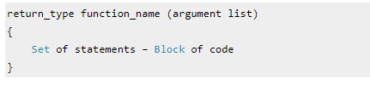
Syntax of a function
return_type: Return type can be of any data type such as int, double, char, void, short etc.
function_name: It is advised to have a meaningful name for the functions.
argument list: Argument list contains variables names along with their data types. These arguments are kind of inputs for the function.
block of code: Set of C statements, which will be executed whenever a call will be made to the function.

Slide 5


Example – To create a function to add two integer variables.
Function will add the two numbers, so it should have some meaningful name like sum, addition, etc.
If we take the name addition for this function, then the syntax becomes,
This function addition adds two integer variables. So needs two integer parameters in the function signature.
The function signature would be –

Slide 6
The result of the sum of two integers would be integer only. Hence function should return an integer value.
Thus the syntax becomes,
Thus the above is the complete function prototype or signature.

Slide 7
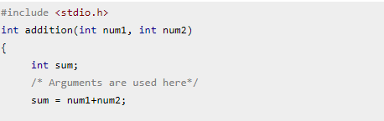
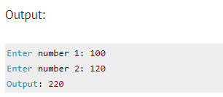
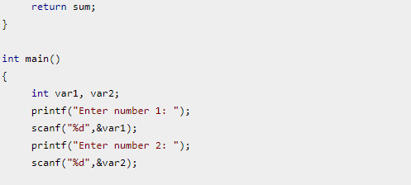
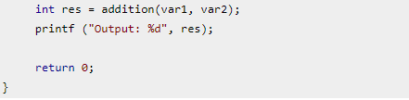
How to call a function in C?

Slide 8
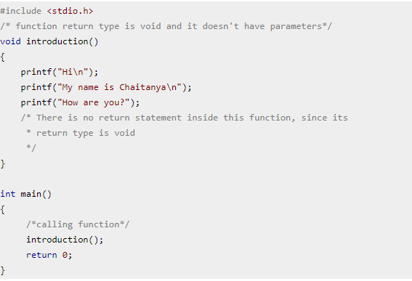
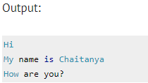
Creating a void user defined function that doesn’t return anything

Slide 9
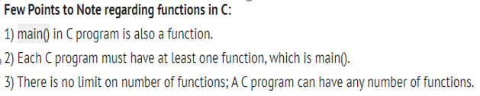


Slide 10

For example: If we have a function declaration like this:
If we are calling the function like this:

Slide 11
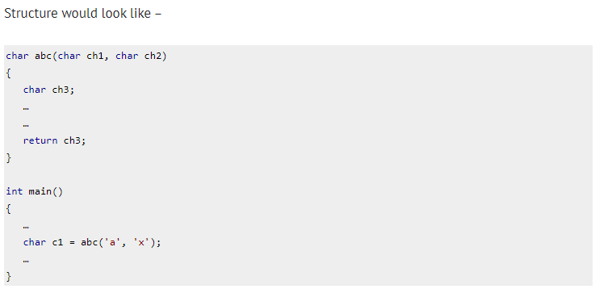
Note: Example: If function return type is char, then function should return a value of char type and while calling this function the main() function should have a variable of char data type to store the returned value.

Slide 12
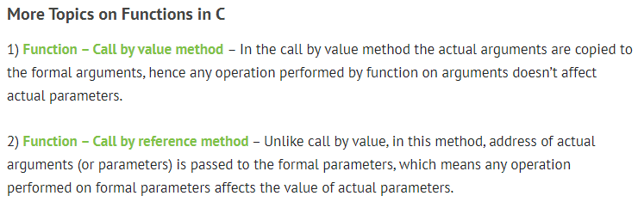

Slide 13

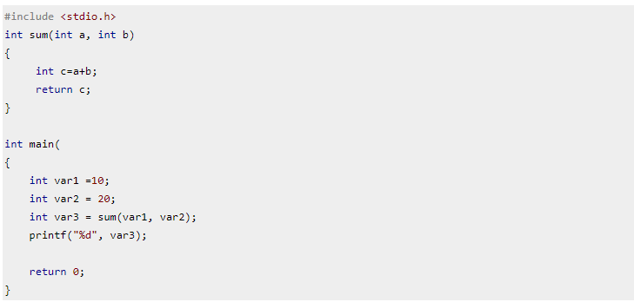

Slide 14
In the above example variable a and b are the formal parameters (or formal arguments).
Variable var1 and var2 are the actual arguments (or actual parameters).
The actual parameters can also be the values.
When we pass the actual parameters while calling a function then this is known as function
call by value.
In this case the values of actual parameters are copied to the formal parameters.

Slide 15
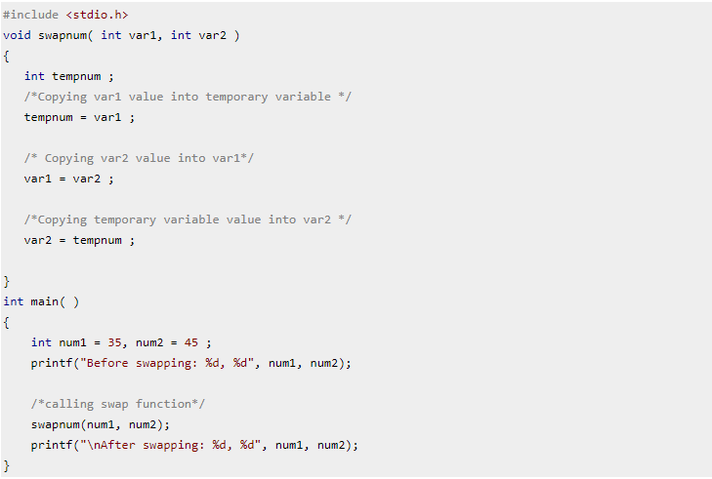
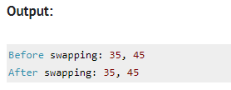
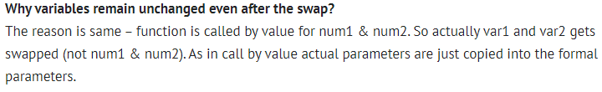
Another Example

Slide 16
Calling a function by passing the addresses of actual parameters.
The operation performed on formal parameters, affects the value of actual parameters.
This is because all the operations are performed on the value stored in the address of actual
parameters.

Slide 17

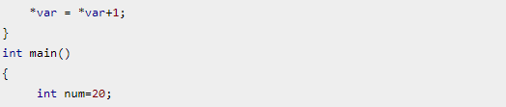


1. Example of Function call by Reference

Slide 18
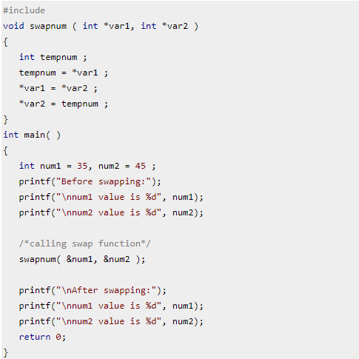
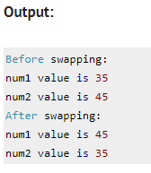
Example 2: Function Call by Reference – Swapping numbers

Slide 19
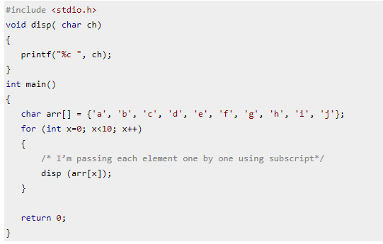

Passing array to function in C programming
Passing array to function using call by value method

Slide 20
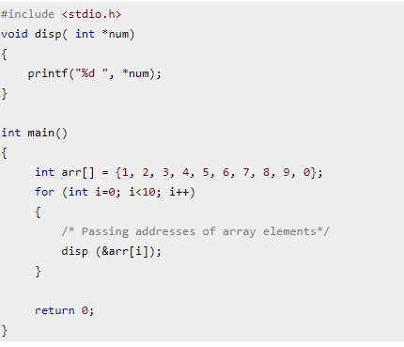

2. Passing array to function using call by reference.

Slide 21

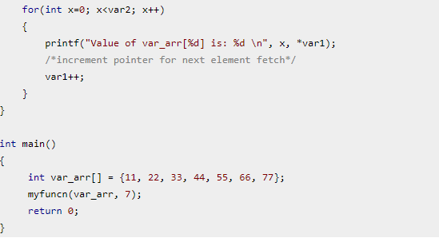
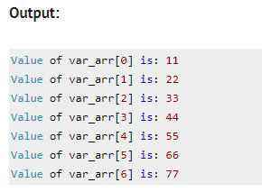
We can also pass an entire array to a function like this:

Slide 22
C – Scope Rules
A scope is a region of the program where a defined variable can have its existence.
There are two places where variables can be declared in C programming language.
Inside a function or a block which is called local variables.
Outside of all functions which is called global variables.
Local Variables
Variables that are declared inside a function or block are called local variables.
They can be used only by statements that are inside that function or block of code.

Slide 23
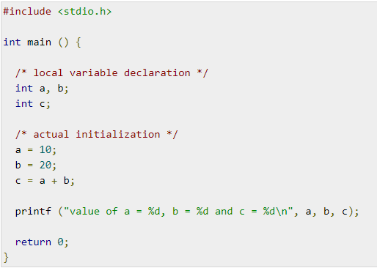
Local Scope: Example.

Slide 24
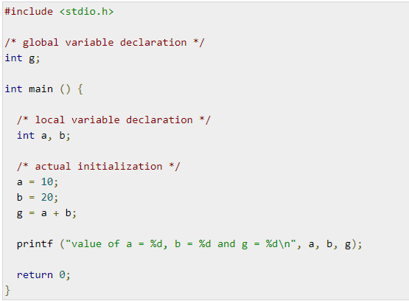
Global Variables
Global variables are defined outside a function, usually on top of the program.
Global variables hold their values throughout the lifetime of your program.
They can be accessed inside any of the functions defined for the program.

Slide 25
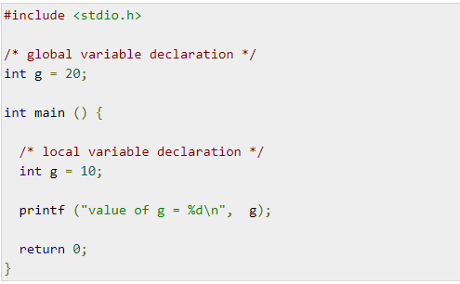

A program can have same name for local and global variables but the value of local variable
inside a function will take preference.
Example:

Slide 26
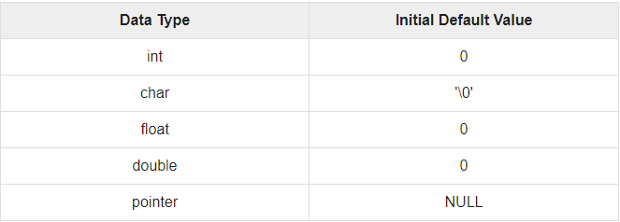
Initializing Local and Global Variables
When a local variable is defined, it is not initialized by the system, you must initialize it yourself.
Global variables are initialized automatically by the system when you define them, as follows:

Slide 27
Storage Classes in C
Storage classes in C are used to determine the lifetime, visibility, memory location, and initial value of a variable.
There are four types of storage classes in C:
i.Automatic.
ii.External.
iii.Static.
iv.Register.

Slide 28
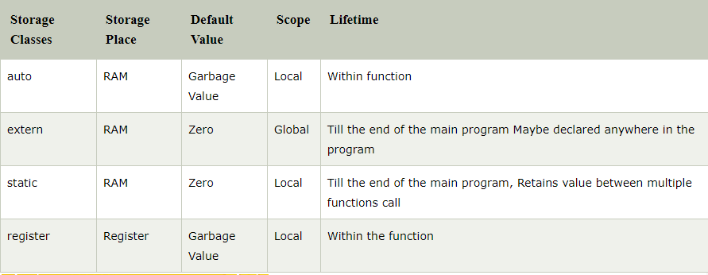

Slide 29
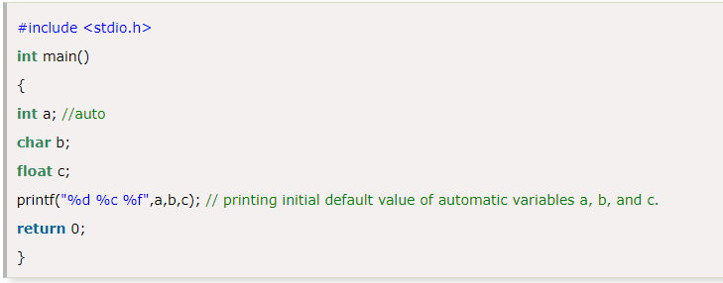

Automatic
Automatic variables are allocated memory automatically at runtime.
The scope of the automatic variables is limited to the block in which they are defined.
The automatic variables are initialized to garbage by default.
The memory assigned to automatic variables gets freed upon exiting from the block.
The keyword used for defining automatic variables is auto.
Every local variable is automatic in C by default.

Slide 30
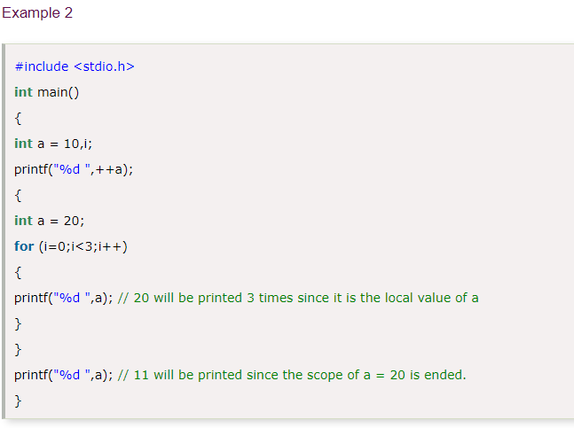



Slide 31
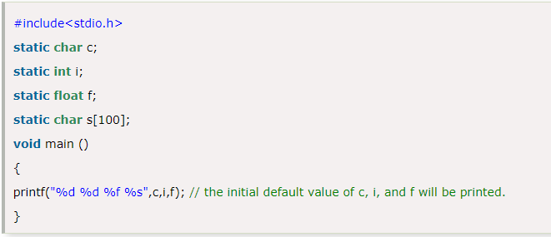
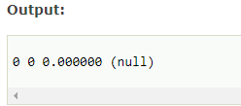
Static
The variables defined as static specifier can hold their value between the multiple function calls.
Static local variables are visible only to the function or the block in which they are defined.
Default initial value of the static integral variable is 0 otherwise null.
The visibility of the static global variable is limited to the file in which it has declared.
The keyword used to define static variable is static.

Slide 32
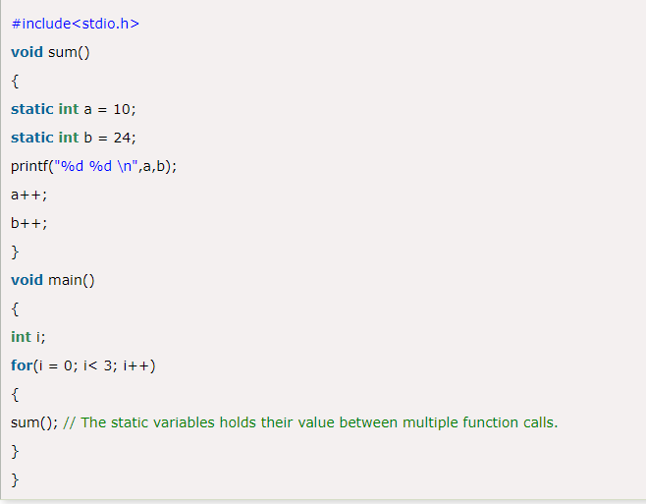
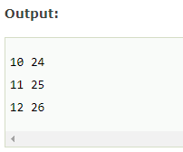
Example 2:

Slide 33
Register
The variables defined as the register is allocated the memory in the CPU registers, depending upon the size of the memory remaining in the CPU.
It is compiler’s choice whether or not the variables can be stored in the register.
We cannot dereference the register variables, i.e., we can not use &operator for the register variable.
The access time of the register variables is faster than the automatic variables.
The initial default value of the register local variables is 0.
We can store pointers into the register, i.e., a register can store the address of a variable.
Static variables can not be stored into the register since we can not use more than one storage specifier for the same variable.

Slide 34
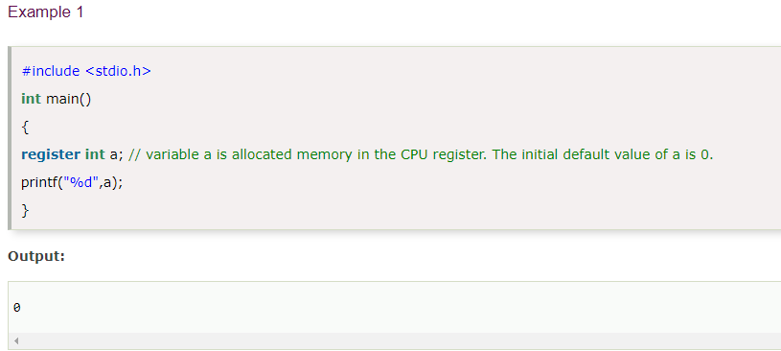

Slide 35
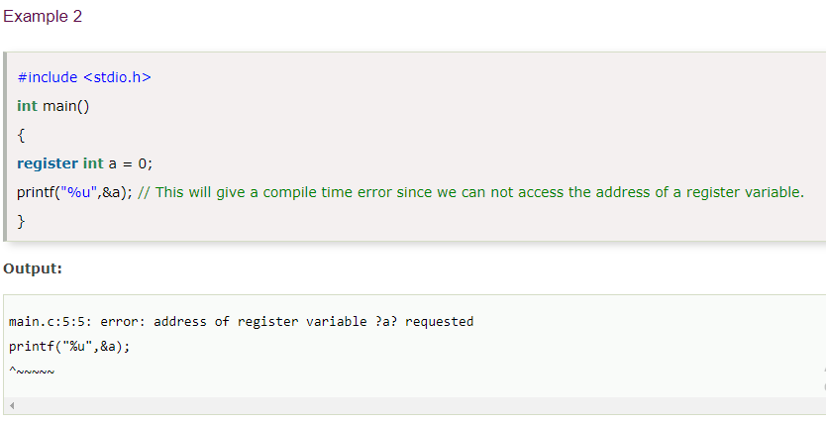

Slide 36
External
Difference between declaration and definition:
i. Declaration of a variable or function simply declares that the variable or function exists somewhere
in the program, but the memory is not allocated for them.
ii. Coming to the definition, when we define a variable or function, in addition to everything that a
declaration does, it also allocates memory for that variable or function.
iii. A variable or function can be declared any number of times, but it can be defined only once.
How would you declare a variable without defining it? You would do like this:
extern int var;
Here, an integer type variable called var has been declared.
It hasn’t been defined yet, so no memory allocation for var so far. And we can do this declaration as
many times as we want.

Slide 37
Now, how would you define var? You would do this:
int var;
In this line, an integer type variable called var has been both declared and defined.
Since this is a definition, the memory for var is also allocated.
We need to include the extern keyword explicitly when we want to declare variables without defining
them.
Also, the extern keyword extends the visibility to the whole program.
By using the extern keyword with a variable, we can use the variable anywhere in the program provided we include its declaration.
Extern keyword is generally used to share variables across source files.

Slide 38
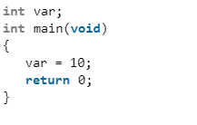
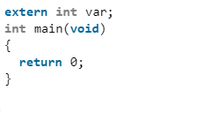
Example 1:
This program compiles successfully. var is defined (and declared implicitly) globally.
Example 2:
Here var is declared only. Notice var is never used so no problems arise.

Slide 39
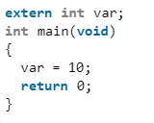
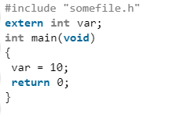
Example 3:
This program throws an error in the compilation(during the linking phase) because var is
declared but not defined anywhere.
Example 4:
Assuming that somefile.h contains the definition of var, this program will compile successfully.

